Slide 1
Chapter 15
Reference Resolution

Slide 2
This chapter …
Reference resolution subsumes several subtasks. This chapter will focus on coreference resolution, which is the task of grouping spans of text that refer to a single underlying entity, or, in some cases, a single event
Coreference resolution is a challenging problem for several reasons. Resolving different types of referring expressions requires different types of reasoning: the features and methods that are useful for resolving pronouns are different from those that are useful to resolve names and nominals.

Slide 3
Forms of referring expressions
There are three main forms of referring expressions — pronouns, names, and nominals

Slide 4
Pronouns
Pronouns are a closed class of words that are used for references.
Search for candidate antecedents;
Match against hard agreement constraints;
And Select using Heuristics, which are “soft” constraints such as recency, syntactic prominence, and parallelism.

Slide 5
Search
In the search step, candidate antecedents are identified from the preceding text or speech
Any noun phrase can be a candidate antecedent, and pronoun resolution usually requires parsing the text to identify all such noun phrases.
In nested noun phrases, mentions are generally considered to be the largest unit with a given head word :thus, Apple Inc. Chief Executive Tim Cook would be included as a mention, but Tim Cook would not, since they share the same head word, Cook

Slide 6
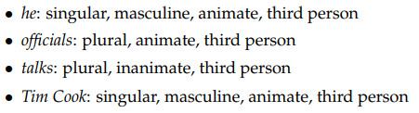
Matching constraints for pronouns
References and their antecedents must agree on semantic features such as number, person, gender, and animacy.
. Consider the pronoun he in this passage from the running example:
The pronoun and possible antecedents have the following features:

Slide 7
Matching constraints for pronouns
Another source of constraints comes from syntax, specifically, from the phrase structure trees.
Consider a parse tree in which both x and y are phrasal constituents. The constituent x c-commands the constituent y if the first branching node above x also dominates y.

Slide 8
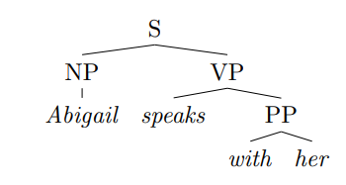
Matching constraints for pronouns
Abigail c-commands her, because the first branching node above Abigail, S, also dominates her.
Now, if x c-commands y, government and binding theory states that y can refer to x only if it is a reflexive pronoun (e.g., herself)
Furthermore, if y is a reflexive pronoun, then its antecedent must c-command it. Thus, her cannot refer to Abigail; conversely, if we replace her with herself, then the reflexive pronoun must refer to Abigail

Slide 9
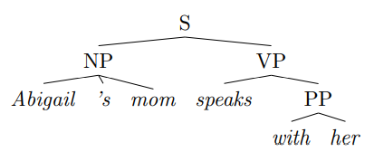
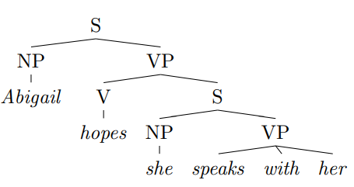
Matching constraints for pronouns
Here, Abigail does not c-command her, but Abigail’s mom does. Thus, her can refer to Abigail and we cannot use reflexive herself in this context, unless we are talking about Abigail’s mom.
In next example, figure shows the how these constraints are limited. In this case, the pronoun she can refer to Abigail, because the S non-terminal puts Abigail outside the domain of she. Similarly, her can also refer to Abigail. But she and her cannot be coreferent, because she c-commands her.

Slide 10
Heuristics
After applying constraints, heuristics are applied to select among the remaining candidates.
Recency is a particularly strong heuristic. All things equal, readers will prefer the more recent referent for a given pronoun, particularly when comparing referents that occur in different sentences.
Readers are expected to prefer the older map as the referent for the pronoun it

Slide 11
Heuristics
However, subjects are often preferred over objects, and this can contradict the preference for recency when two candidate referents are in the same sentence.
Here, we may prefer to link she to Abigail rather than Lucia, because of Abigail’s position in the subject role of the preceding sentence. (Arguably, this preference would not be strong enough to select Abigail if the second sentence were She is visiting Valencia next month.)

Slide 12
Heuristics
A third heuristic is parallelism:
Here Lucia is preferred as the referent for her, contradicting the preference for the subject Abigail in the preceding example.

Slide 13
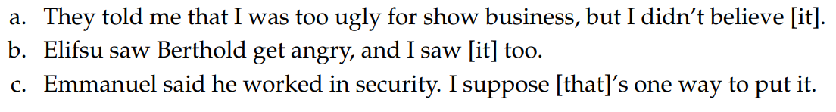
Non-referential pronouns
While pronouns are generally used for reference, they need not refer to entities.
The following examples show how pronouns can refer to propositions, events, and speech acts
These forms of reference are generally not annotated in large-scale coreference resolution datasets such as OntoNotes

Slide 14
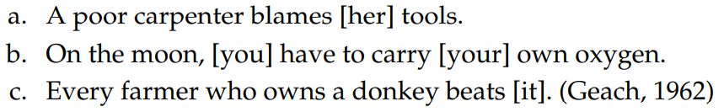
Pronouns
Pronouns may also have generic referents:
In the OntoNotes dataset, coreference is not annotated for generic referents, even in cases like these examples, in which the same generic entity is mentioned multiple times.

Slide 15
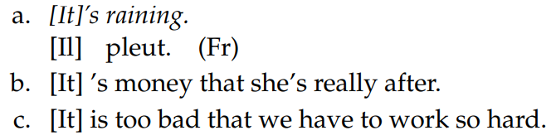
Pronouns
Some pronouns do not refer to anything at all:
How can we automatically distinguish these usages of it from referential pronouns?

Slide 16
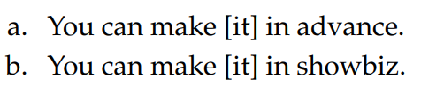

Pronouns
Consider the difference between the following two examples:
In the second example, the pronoun it is non-referential
One way to see this is by substituting another pronoun, like them, into these examples:
The questionable grammaticality of the second example suggests that it is not referential.

Slide 17
Proper Nouns
If a proper noun is used as a referring expression, it often corefers with another proper noun, so that the coreference problem is simply to determine whether the two names match.
Subsequent proper noun references often use a shortened form, as in the running example:

Slide 18
Proper Nouns
A typical solution for proper noun coreference is to match the syntactic head words of the reference with the referent.
We know that the head word of a phrase can be identified by applying head percolation rules to the phrasal parse tree.
For sequences of proper nouns, the head word will be the final token.
Despite these difficulties, proper nouns are the easiest category of references to resolve
In machine learning systems, one solution is to include a range of matching features, including exact match, head match, and string inclusion
In addition to matching features, competitive systems include large lists, or gazetteers, of acronyms, demonyms, and other aliases

Slide 19
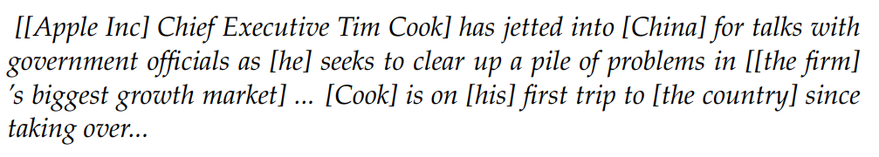
Nominals
In coreference resolution, noun phrases that are neither pronouns nor proper nouns are referred to as nominals
Consider the following example:
nominal references include:

Slide 20
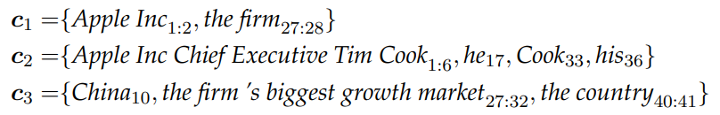
Algorithms for coreference resolution
The ground truth training data for coreference resolution is a set of mention sets, where all mentions within each set refer to a single entity.
Consider the following example:
The ground truth coreference annotation is:

Slide 21
Algorithms for coreference resolution
Each row specifies the token spans that mention an entity
Equivalently, if given a set of M mentions, {mi}M i=1
Each mention i can be assigned to a cluster zi , where zi = zj if i and j are coreferent.
The cluster assignments z are invariant under permutation.
The unique clustering associated with the assignment z is written c(z).
Coreference resolution can thus be viewed as a structure prediction problem, involving two subtasks: identifying which spans of text mention entities, and then clustering those spans.

Slide 22
Mention identification
The task of identifying mention spans for coreference resolution is often performed by applying a set of heuristics to the phrase structure parse of each sentence
A typical approach is to start with all noun phrases and named entities, and then apply filtering rules to remove nested noun phrases with the same head, numeric entities, non-referential it, …
An alternative is to consider all spans (up to some finite length) as candidate mentions, performing mention identification and clustering jointly

Slide 23
Mention clustering
The subtask of mention clustering will be the focus of the remainder of this chapter.
There are two main classes of models. In mention-based models, the scoring function for a coreference clustering decomposes over pairs of mentions.
These pairwise decisions are then aggregated, using a clustering heuristic.
Mention-based coreference clustering can be treated as a fairly direct application of supervised classification or ranking.
Entity-based models address this issue by scoring entities holistically. This can make inference more difficult, since the number of possible entity groupings is exponential in the number of mentions.

Slide 24
Mention-pair models

